Slide 1


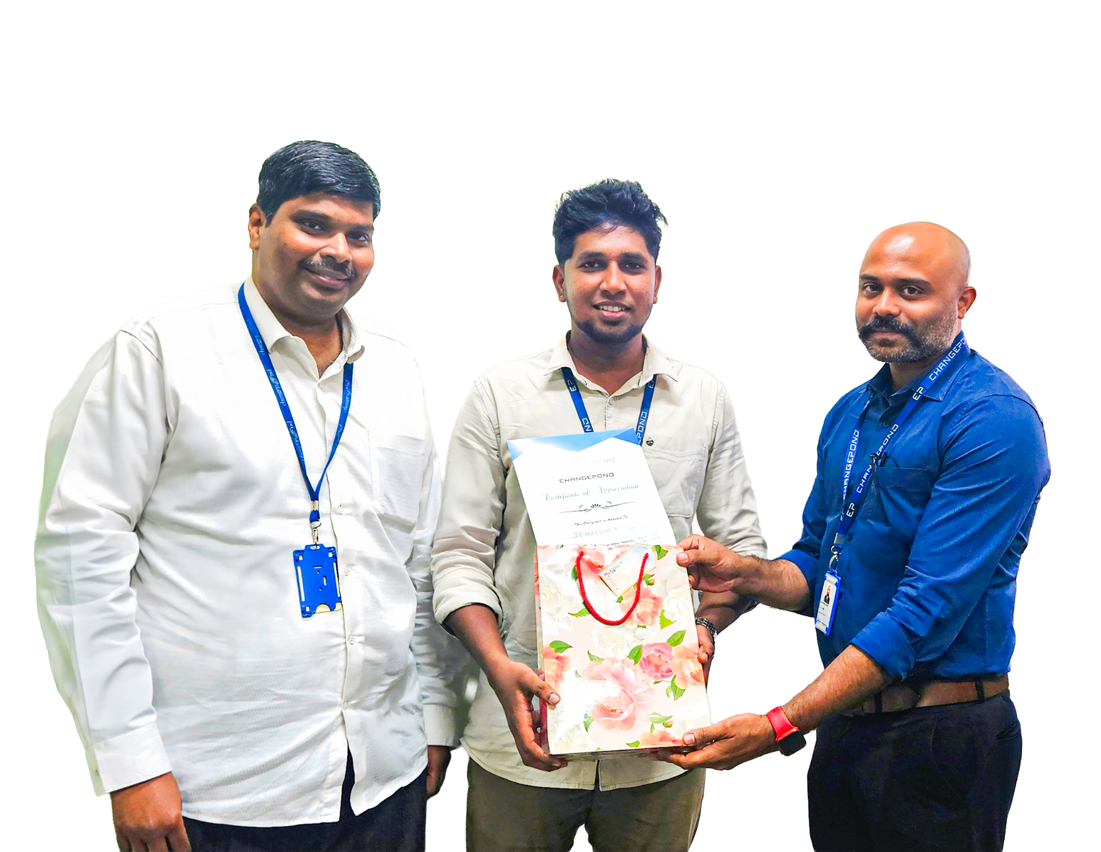



Congratulations…
Divakaran K
(SIX)
Receiving goodie bag from
Daniel & Krishnakanth

